Slide 1
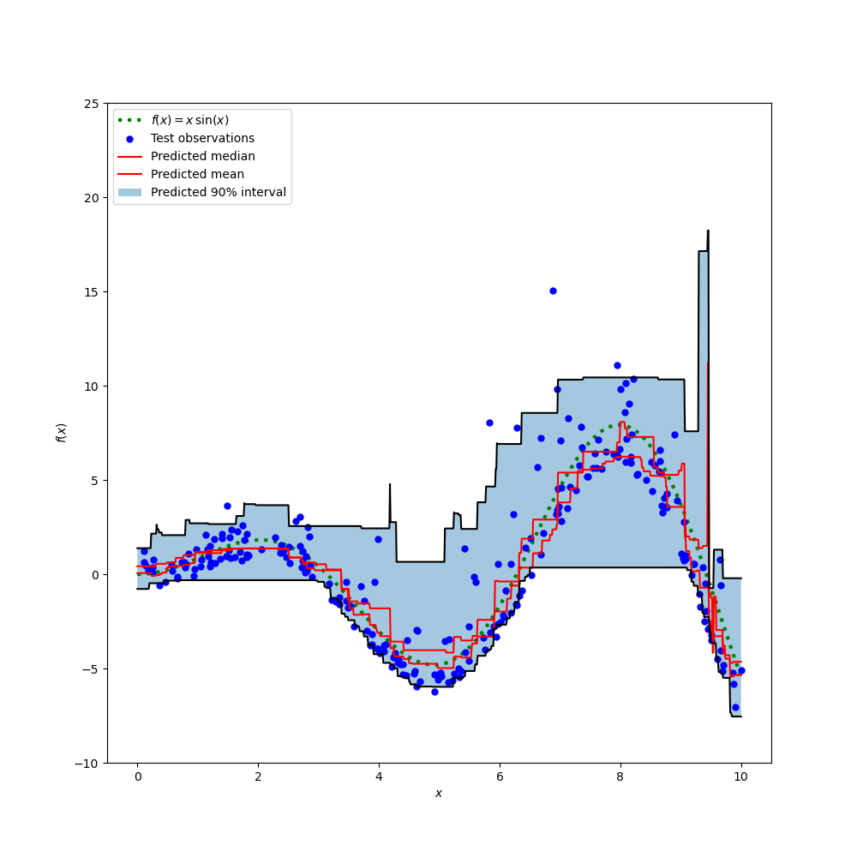
LGBoost Algorithm
LightGBM is short term for Light Gradient Boosting Machine
It is Fast, Efficient and scalable
Built for high-performance machine learning
— especially for structured/tabular data.

Slide 2
Features of LGBM
Handles large datasets efficiently
Low memory usage
Faster training than XGBoost
Can handle missing values

Slide 3
How it works?
Starts with an initial prediction
Fits a decision tree to the residuals (error)
Uses gradient boosting to minimize loss (like MSE)
Builds trees in a leaf-wise manner for better accuracy
Repeats for n_estimators rounds

Slide 4
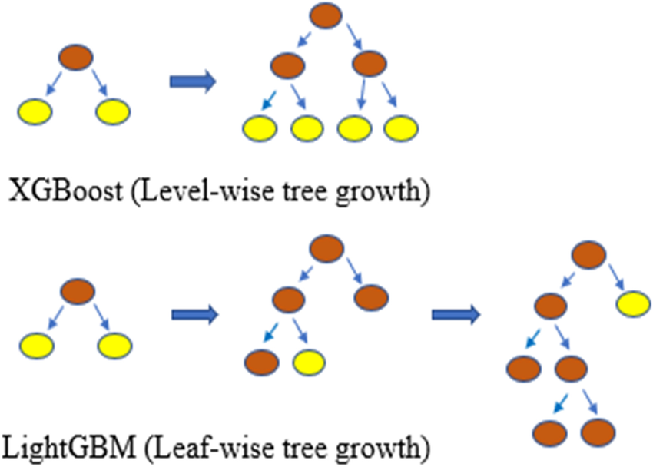

Slide 5
Advantages of LGBoost
Very fast training speed
Handles large datasets easily
Supports categorical features directly
High accuracy
Automatically handles missing values
Uses leaf-wise tree growth
Reduces overfitting with regularization
Good for both regression and classification

